Slide 1
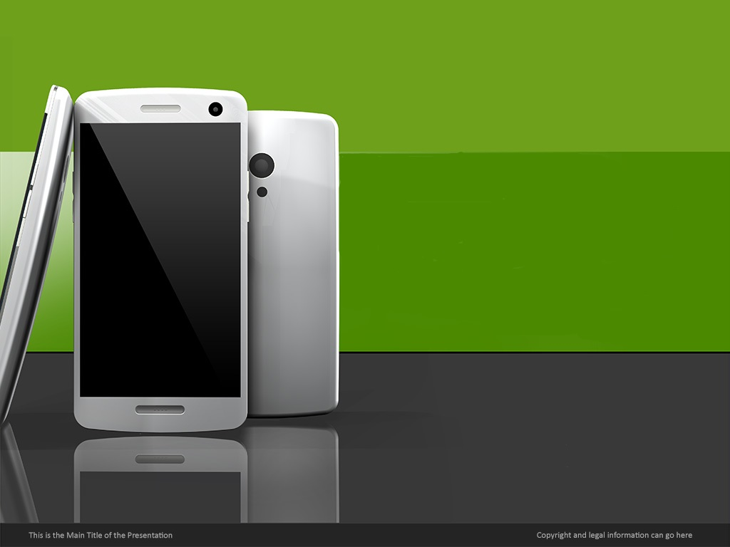
Understanding the mobile phone market
Atharva Pathak
MSc Sem 1

Slide 2
Goal and methods used -
GOAL: To understand consumer preferences while buying a mobile phone.
Method:
Collected some data using a survey.
Tried to understand the data using some basic visuals.
Cleaned and analyzed the data using R.
Used the method of conditional probability, marginal distribution and chi-square test to get some insights.
Survey link
Google form

Slide 3
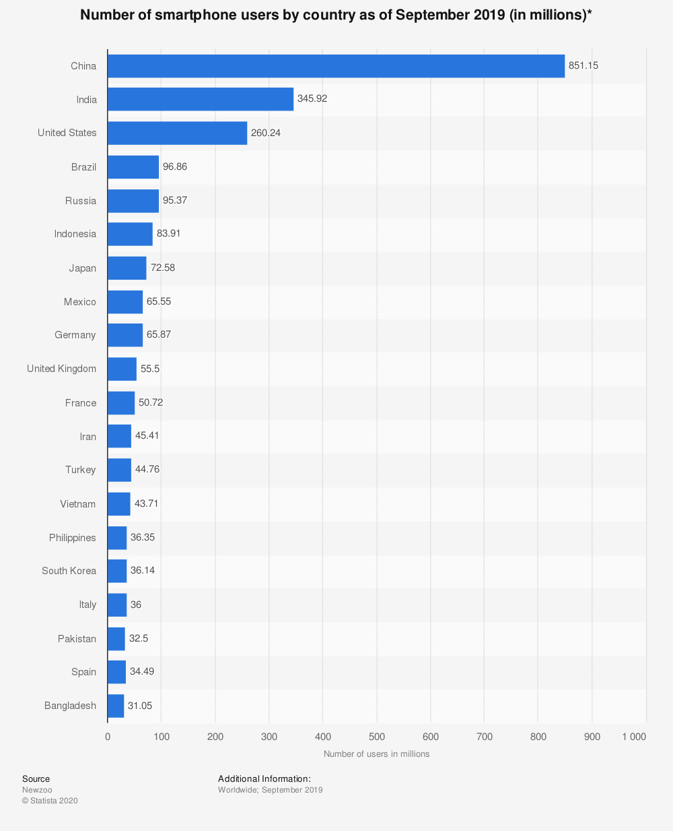
Some facts about Indian phone market
India is the second-largest mobile market, ahead of the US with over 350 million smartphone users whereas China leads in terms of the number of users.
As per counterpoint research, about 33% of phones sold are in Rs. 11,000 to Rs. 18,000 price range , and is the fastest-growing segment.

Slide 4
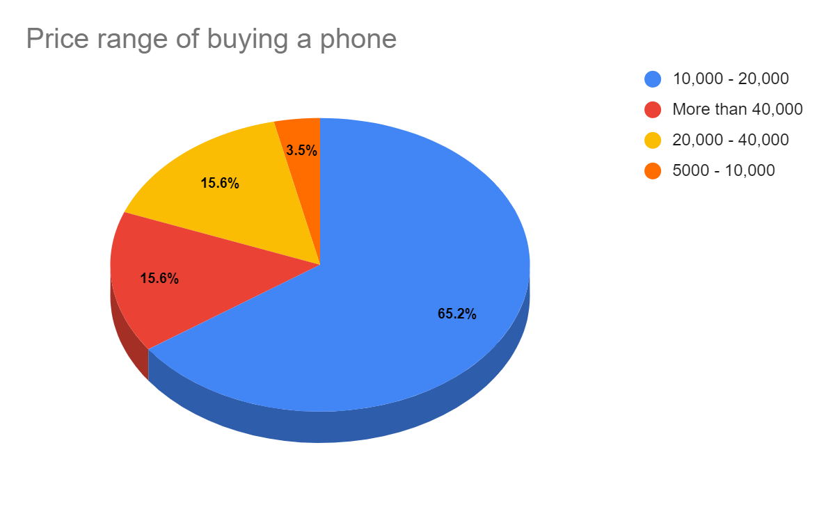
Some basic visuals from the raw data
Most people buy a phone in the price range of 10,000 to 20,000.

Slide 5
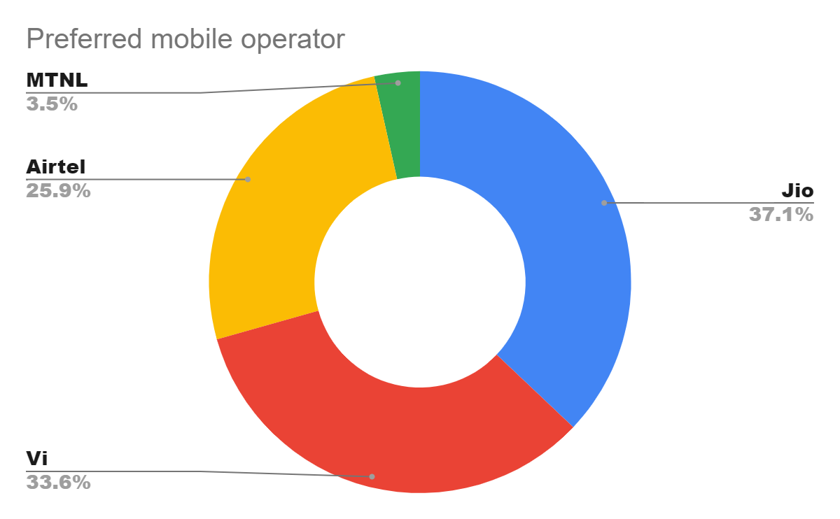
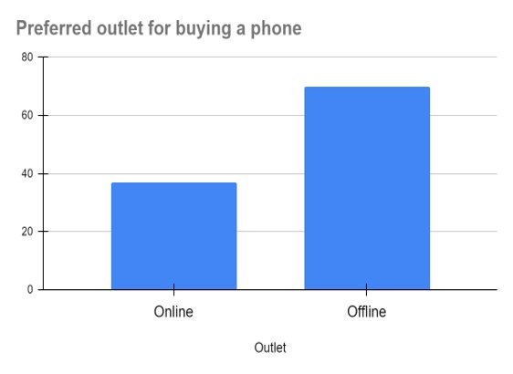
Most people buy a phone offline I.e. from physical electronics store.
The preferred mobile operator is Jio

Slide 6
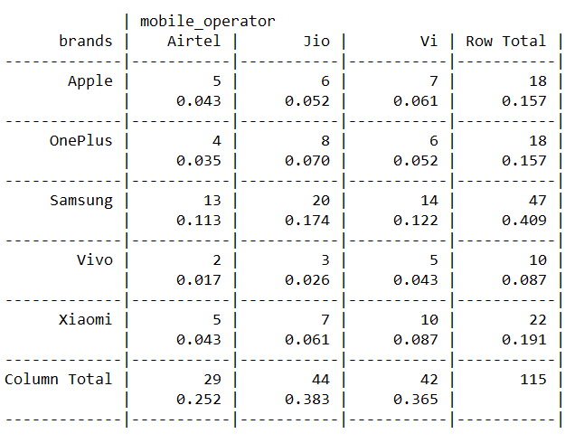
Bivariate distribution between brand of phone and mobile operator

Slide 7
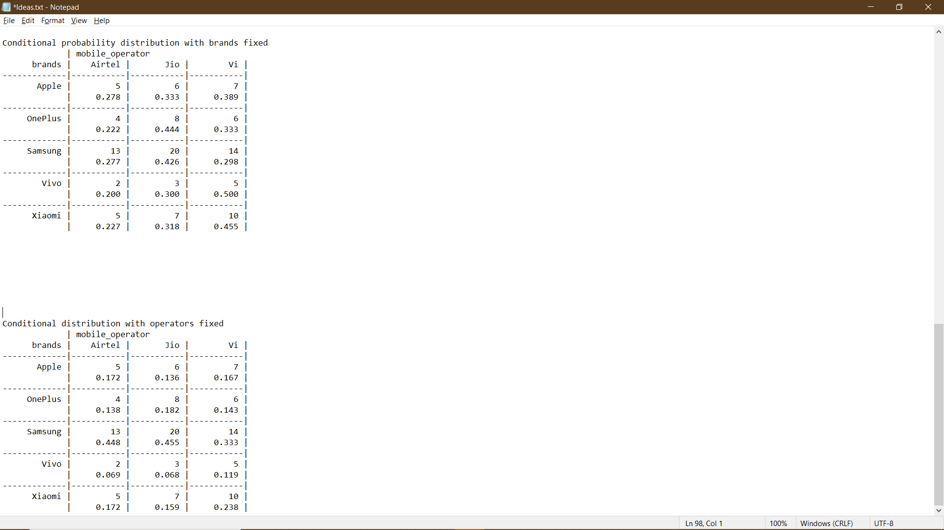
Conditional probability distribution with brands fixed
Conditional probability distribution with operators fixed

Slide 8
Conclusions from marginal and conditional distributions
The marginal distribution of brand of phone shows that most people use a Samsung phone.
The marginal distribution of operators shows that most people use Jio sim card.
From the conditional distributions with brands fixed it is evident that
Apple (39%), Vivo (50%) & Xiaomi (45.5%) users prefer VI.
OnePlus(44.4%) & Samsung(42.6%) users prefer Jio sim.

Slide 9
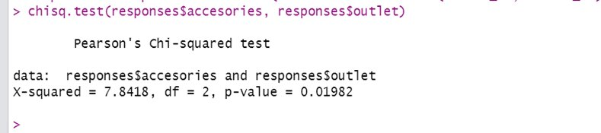
Hypothesis testing using chi-square test of independence
H₀ – Buying accessories while buying a phone is independent of the outlet(online/offline) where the phone is bought from.
H₁ – Buying accessories while buying a phone is not independent of the outlet(online/offline) where the phone is bought from.
As the p-value is less than 0.05, we reject the null hypothesis.
Hence, we conclude that buying accessories is not independent on the outlet(online/offline) where the phone is bought from.

Slide 10
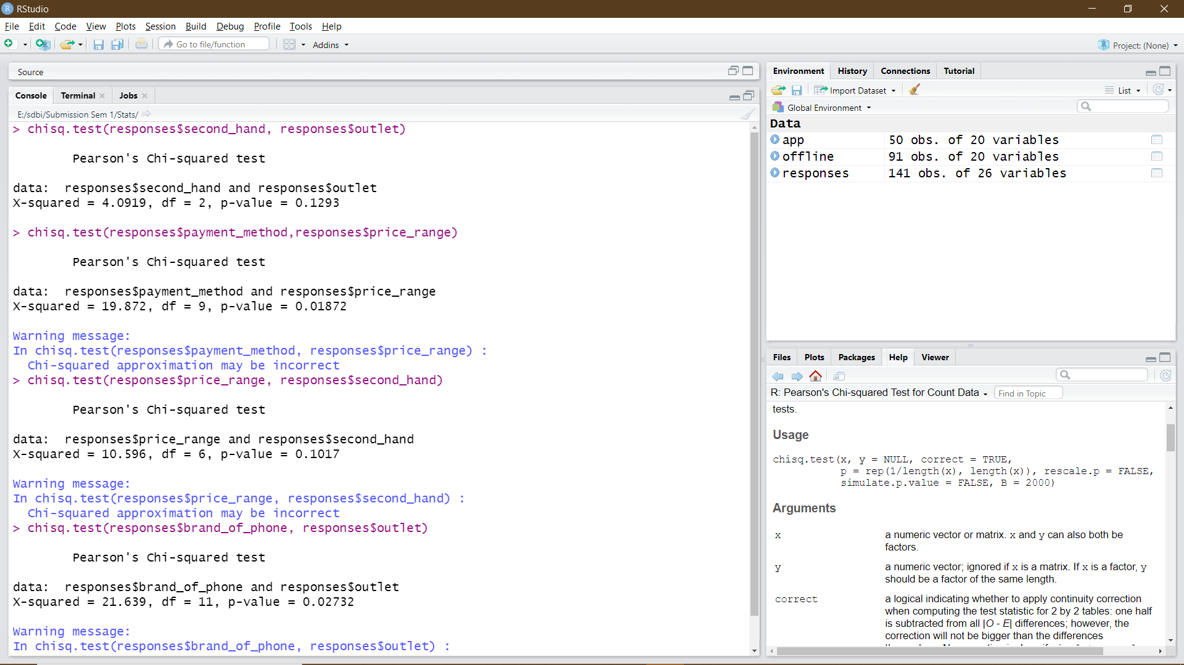
H₀ – Buying a second hand phone given a choice is independent of the preferred outlet.
H₁ – Buying a second hand phone given a choice is not independent of the preferred outlet.
As p-value is not less than 0.05 we can accept null hypothesis.
So in conclusion we can say that buying a second phone is independent of the preferred outlet.

Slide 11
H₀ – Preferred payment method is independent of the usual price range of buying a phone
H₁ – Preferred payment method is not independent of the price range in which the phone is purchased
As p-value is less than 0.05 we reject null hypothesis.
So in conclusion we can say that preferred payment method is not independent of the price range in which the phone is purchased

Slide 12
H₀ – The choice of buying a second hand phone is independent of the usual price range of buying a phone
H₁ – The choice of buying a second hand phone is not independent of the usual price range of buying a phone
As p-value is not less than 0.05 we accept null hypothesis.
So in conclusion we can say that The choice of buying a second hand phone is independent of the usual price range of buying a phone

Slide 13
H₀ – The preferred outlet is independent of the preferred brand of phone
H₁ – The preferred outlet is not independent of the preferred brand of phone
As p-value is less than 0.05 we reject null hypothesis.
So in conclusion we can say that preferred outlet is not independent of the preferred brand of phone

Slide 14
Conclusion
On further analysis of the first test it was evident that people usually prefer to buy accessories along with the phone when they're buying it offline and not while buying online.
Customers prefer to use cash/card to pay for lower price range phones whereas UPI to pay for higher price range phones.
It is also evident that people prefer buying high to mid-range phones like Apple, Samsung & OnePlus offline whereas mid to low range phones like Xiaomi, Realme online.
Analyzing the data further we can conclude that when given an option people will prefer buying a second hand phone online rather than offline.

Slide 15


